Slide 1
Do Community Recommendations Improve Metadata Completeness?
NSF-DIBBS Award 1443062
Sean Gordon (scgordon@hdfgroup.org), Ted Habermann, John Kozimor, and Lindsay Powers, The HDF Group. Matt Jones, NCEAS
Exactly how records are selected

Slide 2

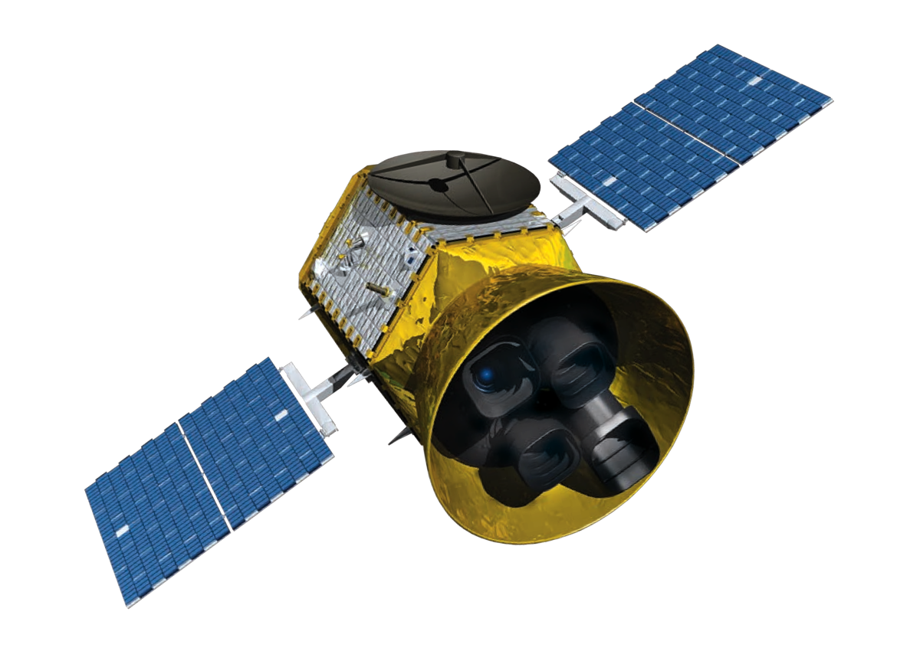
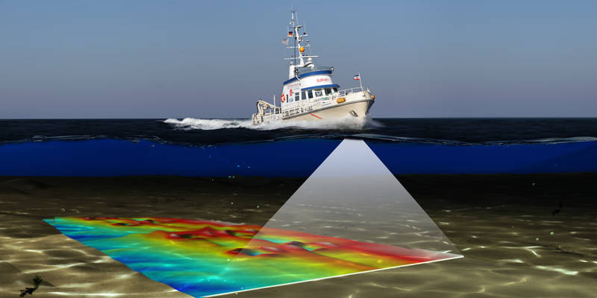



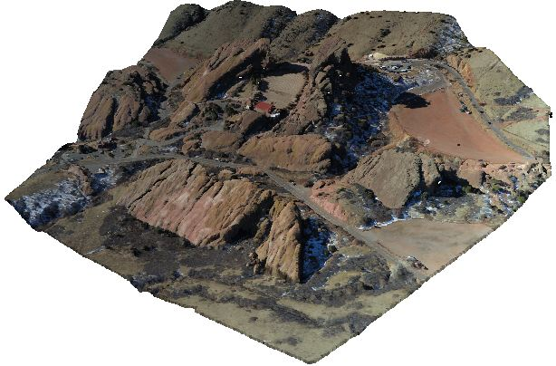

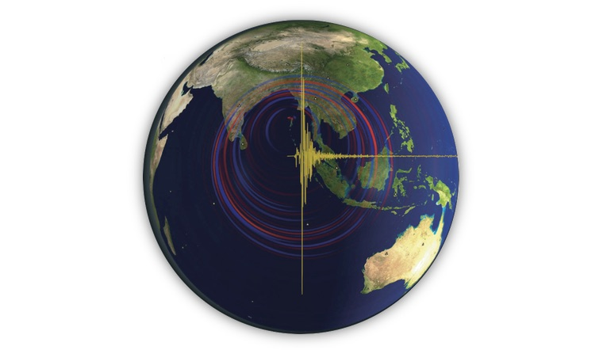
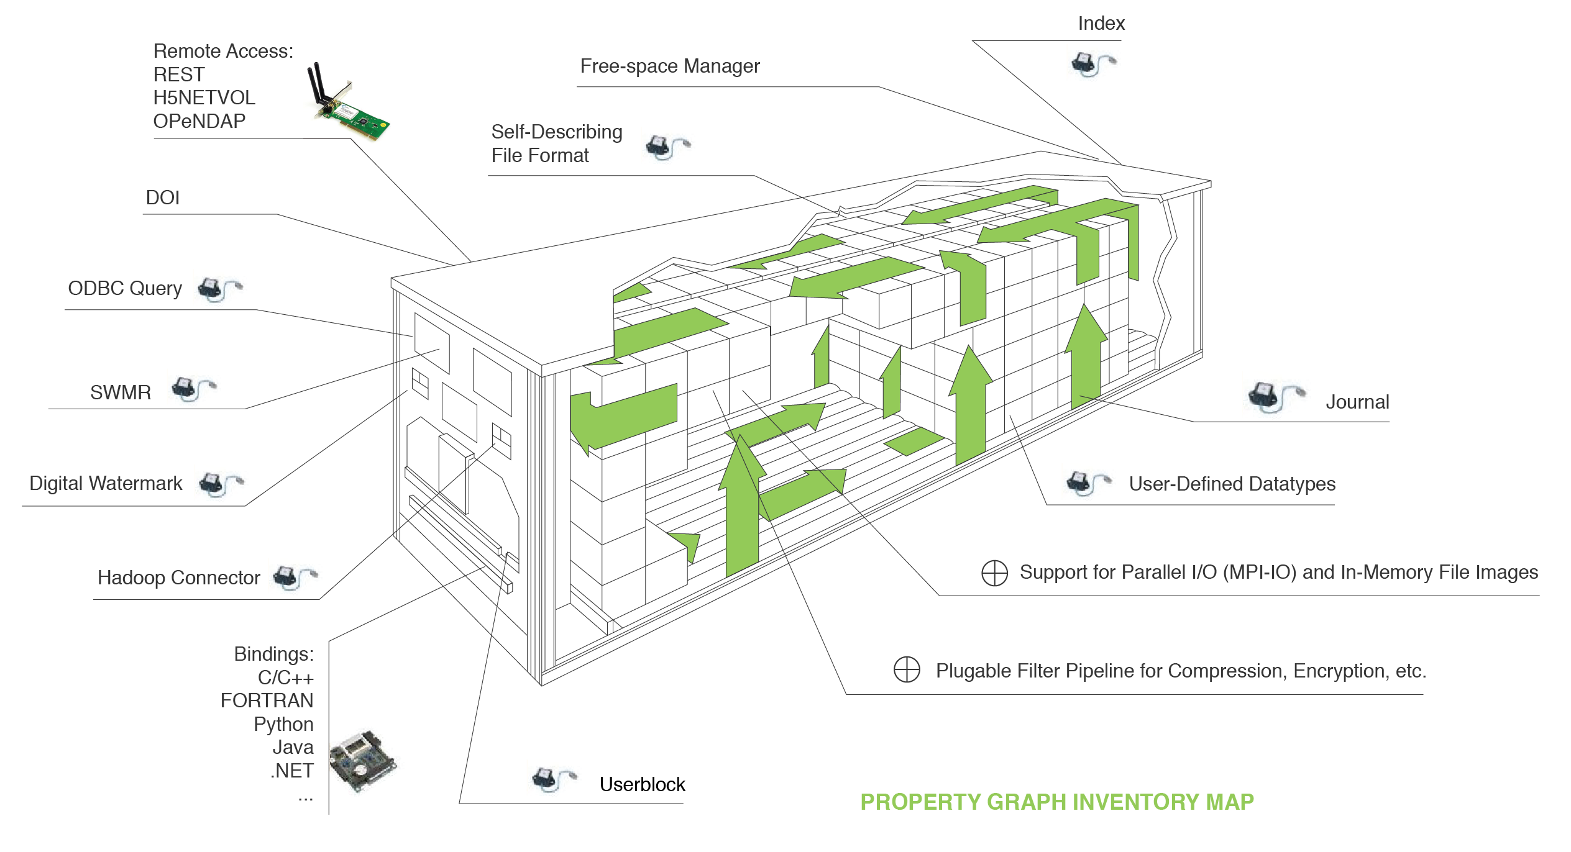


The HDF Data Format: High Performance Interoperability for Earth Science Communities
Communities customize HDF by creating metadata and data structure conventions for describing datatypes that are specific to their domain
Sean Gordon (scgordon@hdfgroup.org), Ted Habermann, and John Kozimor, The HDF Group. Lindsay Powers, USGS
HDF Communities
hydrography
Planetary science
Earth Observation
Community Conventions
Seismology
Atmospheric and Oceanographic Science
BAG
OpenNavSurface
International Hydrographic Organization
Tabular metadata
Annotations
Grids
FITSinHDF
Imagery
Ecology and Point Cloud
HDF-EOS
Swaths
Multi-dimensional Grids
Zonal averages
Points
ASDF
NetCDF / CF
Multi-dimensional Grids
Discrete Sampling Features
Non named standard template
Notes:
Datatypes: Swaths, time, series grids. IDL
Common framework
Community conventions are important as they provide a convention to describe datatypes that are specific to their domain
Communities use hdf by creating metadata and data structure conventions describing datatypes that are specific to their domain
Communities customize HDF by creating metadata and data structure conventions for describing datatypes that are specific to their domain
Add qcode poster number
Consider adding matlab is a tool that uses hdf as a format .mat wrapper around hdf

